Slide 1
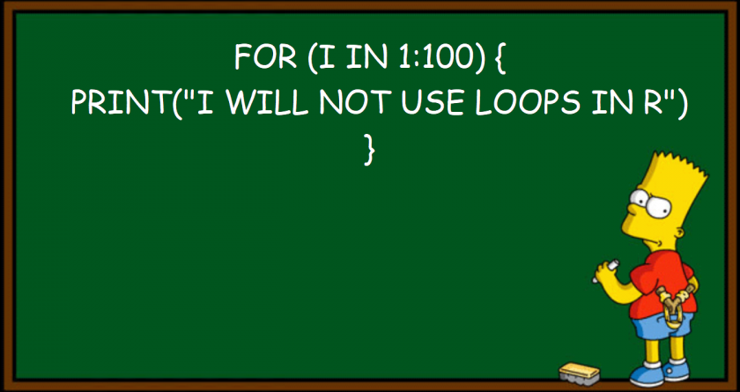
indexing, for Loops, and apply() functions
**Note: Who cares if you use for loops in your code?? Use whatever works
R Users 1/7/2021
Kayla Blincow

Slide 2
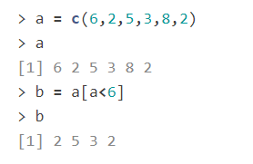
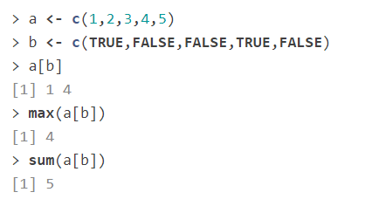
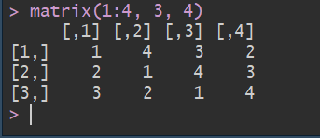
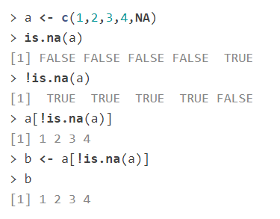
Indexing in R
The basics
Vector indexing
a <- c(1, 4, 7, 0, 15)
a[4] –if I run this what will I get?
Indexing with logicals
Indexing with NAs
Logical Expression indexing
Indexing with dataframes/matrices
d <- matrix(1:4, 3, 4)
d[rows, columns]
d[3, 3] – if I run this what will I get?
d[, 2] – if I run this what will I get?
Note: d[3, 3] is the same as matrix(1:4, 3, 4)[3, 3] – right?

Slide 3
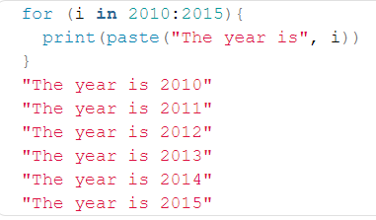
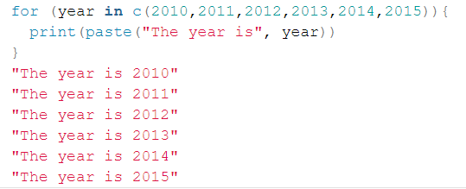
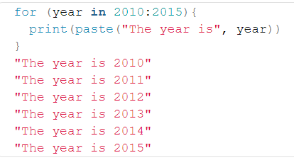
for loops
for loops use indexing to “loop” over values in a vector and do something to each value

Slide 4
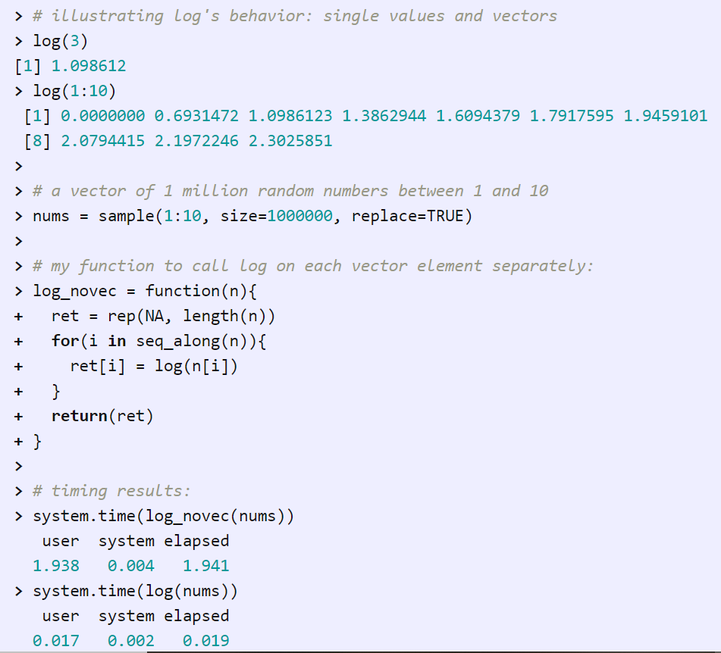
Vectorization… What’s that?
R gets heat from other coding languages for being slow at looping (hence the Bart Simpson meme)
BUT R has something most other languages don’t.. VECTORIZATION
Basically most of R’s functions can run on vectors (not just single values)

Slide 5
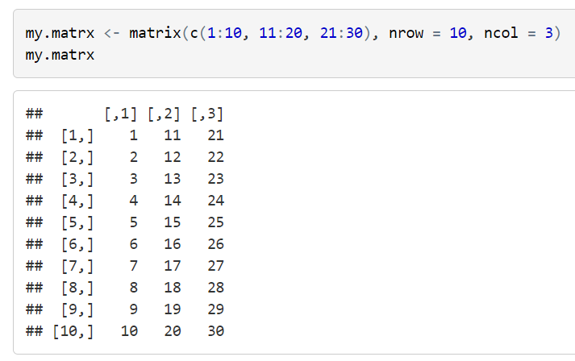
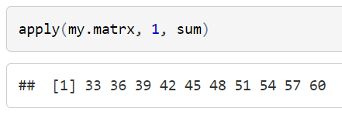
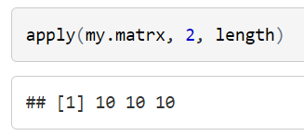
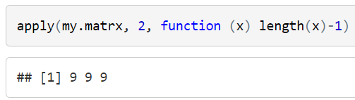
apply() functions
For more check out this online tutorial: https://ademos.people.uic.edu/Chapter4.html
These are functions that iterate like a loop, but generally fun faster and often require less code
apply(): most basic function, takes an array or matrix
lapply(): takes a vector or list, and returns a list
sapply(): same as lapply(), but will simplify the output if possible. So if it can return a vector instead of a list, it will.
vapply(): similar to sapply() except you specify why type of data you are expecting
mapply(): similar to sapply() but allows you specify multiple elements

Slide 6
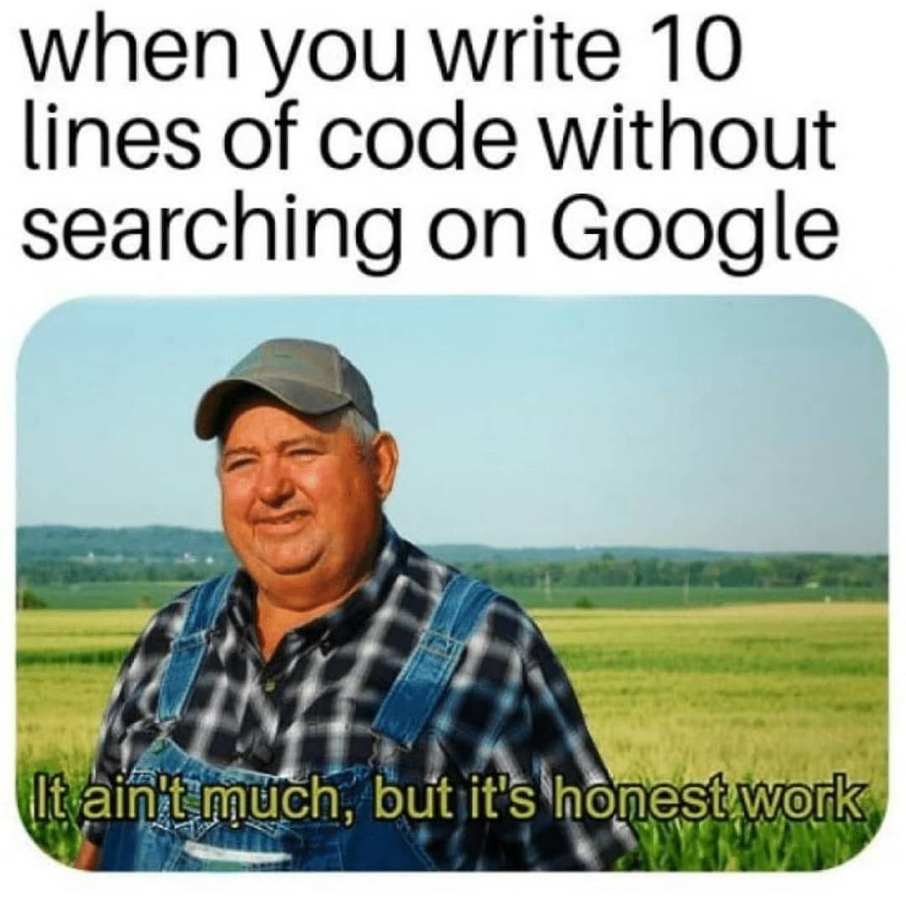
Switch to code!

